Slide 1


Citizen Scientist Project iOS
Application 1.0
Team Members: Emmanuel Malave, David Gonzalez
Product Owner: Nathan Moyer
Instructor: Masoud Sadjadi
School of Computing and Information Sciences Florida International University
Final Presentation
Spring 2018
Notes:
7 seconds
-Greet audience,
-Thank them for attending your presentation
-Introduce yourself, your project, your team members, and quickly indicate what each of you did in a high-level manner
Note: Put more emphasis on your part/contribution.

Slide 2

Project’s Purpose
An iOS application was requested to help The Key Biscayne Citizen Scientist Project further fulfill their mission of having citizen and professional scientists monitor, protect and share information on the most critical natural resources of Key Biscayne.
The iOS application aims to feature the information provided on the Key Science website as well as integrating:
Offline viewing
An easier to use mobile user interfaces
User profiles
The Geo Hunt educational game.
Notes:
20 seconds.
Introduce the problem of the overall project

Slide 3
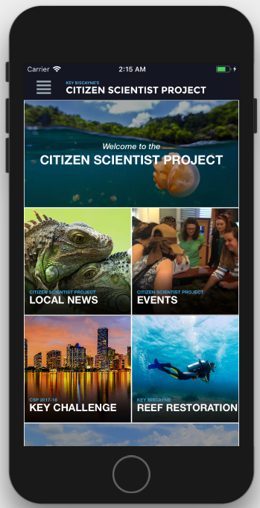
Semester’s Goals
During this release the team focused on:
Brainstorming, designing and evaluating the application’s design and mobile user experience
Developing the foundational architecture of the application
Integrating the offline viewing pages
Notes:
20 seconds.
Introduce the problems that were tackled in this semester

Slide 4
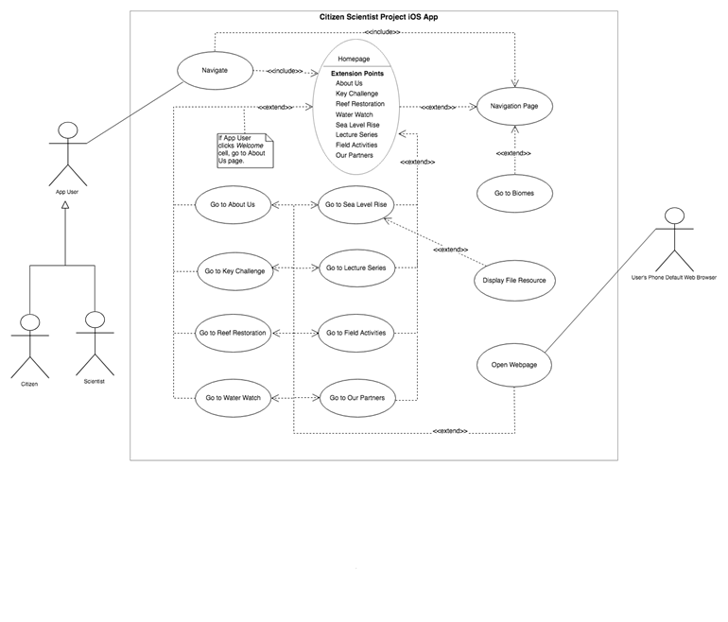
Project Use Case Diagram
Notes:
5 seconds
Show the Use Case Diagram for the whole project. Highlight your use cases.

Slide 5
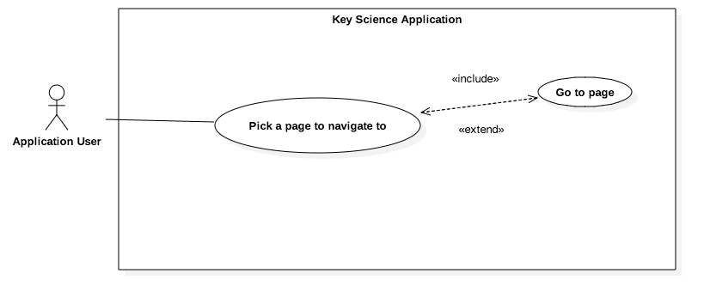
Use Case Focused Example
Name: Pick a page to navigate to
Actors: Application User
Preconditions:
Application is correctly loaded
The user goes into the Navigation page from either the Home page or any other page that links to it through their header.
Flow of Events:
User opens application
From the Home page or any other page with the menu button in their header, the user presses the menu button
The user goes into the Navigation page and picks from the vertically scrollable table cells which page he would like to navigate to by pressing the cell which references it
The user goes into the page they selected
From the page the user picked they can then again go into the Navigation page to navigate to another page
Notes:
5 seconds
Show the Use Case Diagram for the whole project. Highlight your use cases.

Slide 6
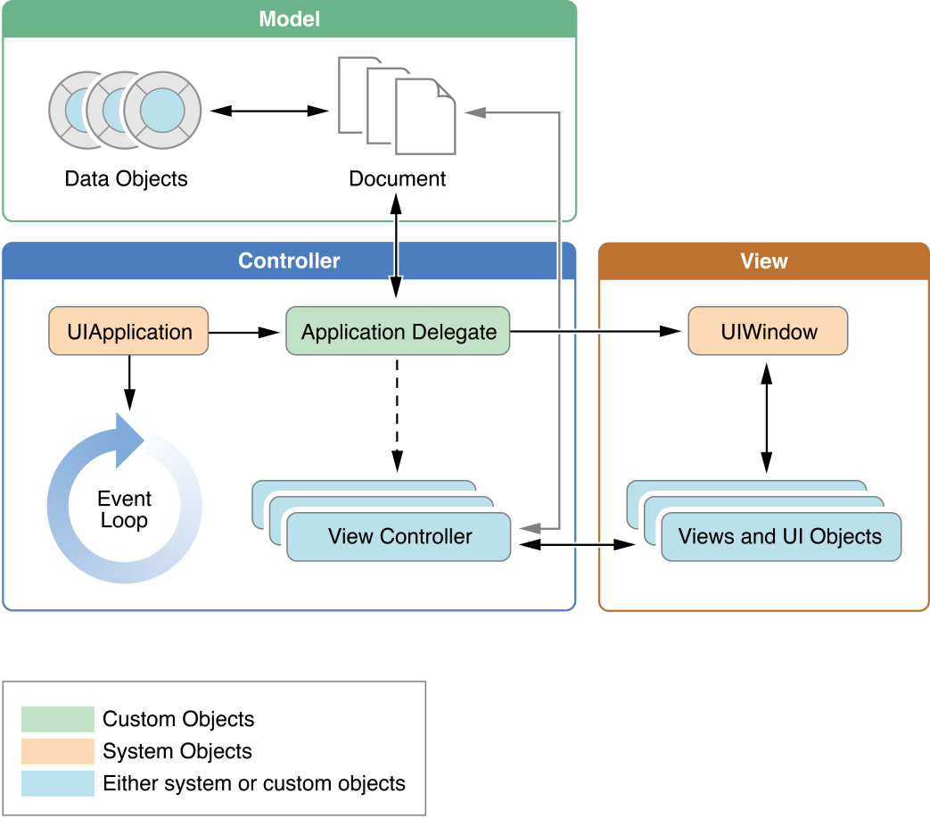
System Design: Architecture
Model-View-Controller (MVC) Components:
Model: The model is responsible for directly managing the data, logic and rules of the application.
View: The view is responsible for representing the information (data model) with a number of defined UI elements. It also triggers events in response to user input.
Controller: Responds to the user input and performs interactions on the data model objects. It is responsible for binding and updating both the data model objects and the views (user interface).
Notes:
20 seconds
System design: Highlight the parts that you contributed to them.
System decomposition; identify the architecture patterns

Slide 7
User Stories
User Story #668 – Create the Navigation page*
User Story #669 – Create About Us page*
User Story #670 – Create the application’s header*
User Story #671 – Create Social Media Footer
User Story #672 – Create Home page
User Story #673 – Create Key Challenge page*
User Story #674 – Create Mini Challenge page
User Story #675 – Create Previous Winners page
User Story #676 – Create Water Watch page
User Story #677 - Create Sea Level Rise page
User Story #678 – Create Reef Restoration page*
User Story #679 – Create Lecture Series page
User Story #680 – Create Field Activities page
User Story #681 – Create Biomes page*
User Story #682 – Create Our Partners page*
User Story #693 – Create Reef Restoration – Dive Trip page*
User Story #712 – Expand CSP Lab
User Story #713 – Create Reusable Frameworks and Organize Code
Notes:
5 seconds.
List the user stories that you worked on them.

Slide 8
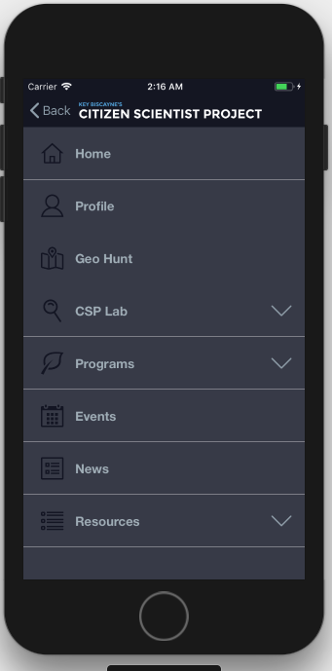
User Story #668 - Create Navigation page
Description:
As a user, I want a navigation page that can be accessed through every main page, so that I can access the main components of the app with ease.
Acceptance Criteria:
Navigation page should show into view when the user presses the menu header button
When any parent element, that contains child elements, is pressed the child elements should slide/expand downward
Every parent elements that contains child elements, should have a downwards arrow to the right of them
Elements should show a small icon to their left to help users visualize the different elements
When the navigation menu is initially showed it should only show parent elements
Navigation page should be vertically scrollable
The header button should have the “Back” text and take the user to the previously visited page when pressed
Notes:
60 seconds
The tile of user story
The most important user story you worked on it. You have to describe this one very well and be proud of that.
Please present and show the complexity of your work, code, algorithms, and technical challenges and technologies you have used. (you could use screenshot if you want. Visual presentations are better than text presentation)
Go into the details of the most important/significant tasks using bullet lists or visual graphs or state chart diagram
Sequence Diagram for this user story is mandatory (in another separate page if required)
Demo using screenshots or GIF (in another separate page if required)

Slide 9
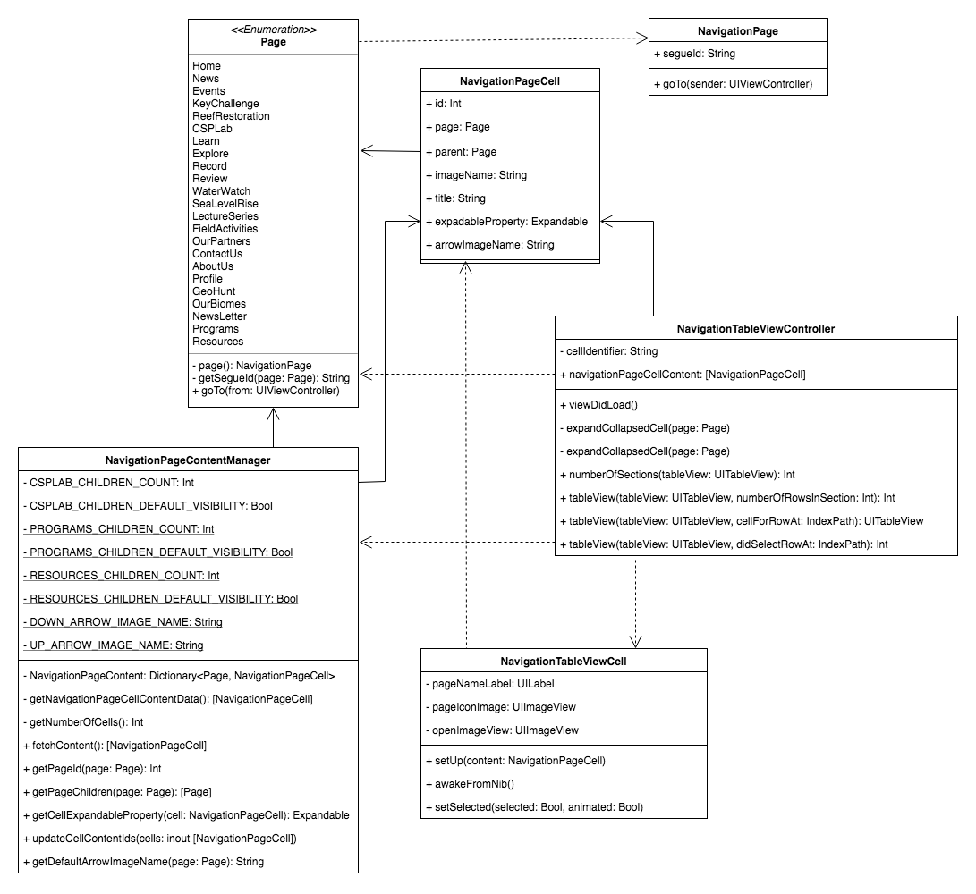
Class Diagram
Notes:
60 seconds
The tile of user story
The most important user story you worked on it. You have to describe this one very well and be proud of that.
Please present and show the complexity of your work, code, algorithms, and technical challenges and technologies you have used. (you could use screenshot if you want. Visual presentations are better than text presentation)
Go into the details of the most important/significant tasks using bullet lists or visual graphs or state chart diagram
Sequence Diagram for this user story is mandatory (in another separate page if required)
Demo using screenshots or GIF (in another separate page if required)

Slide 10
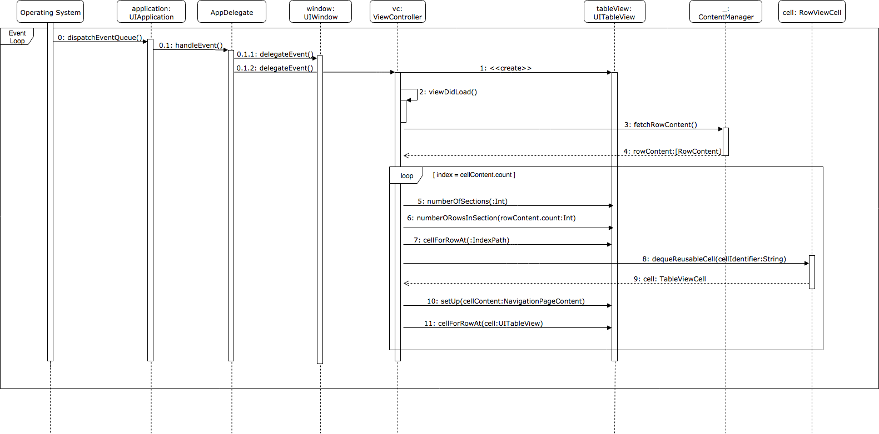
Sequence Diagram
Notes:
60 seconds
The tile of user story
The most important user story you worked on it. You have to describe this one very well and be proud of that.
Please present and show the complexity of your work, code, algorithms, and technical challenges and technologies you have used. (you could use screenshot if you want. Visual presentations are better than text presentation)
Go into the details of the most important/significant tasks using bullet lists or visual graphs or state chart diagram
Sequence Diagram for this user story is mandatory (in another separate page if required)
Demo using screenshots or GIF (in another separate page if required)

Slide 11
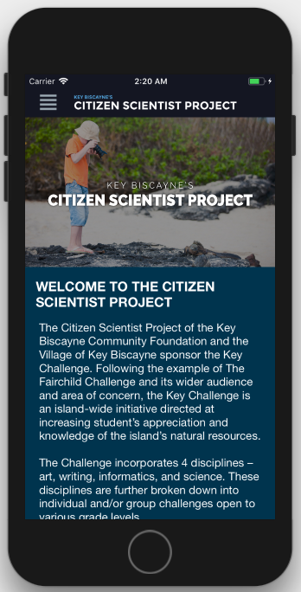
User Story #669 Create About Us page
Description:
As a user, I want a About Us page, so that I can learn about The Key Biscayne’s Citizen Scientist Project’s goals, history and partners.
Acceptance Criteria:
Reflect the information given about The Foundation in the home page of the website
Show the Explore the Scientist Project Lab options in a horizontal slider
Show the Get involved options in a horizontal slider
Show the partners logo in the bottom of the page above the footer
Notes:
20 seconds
The tile of user story
Please present and show the complexity of your work, code, algorithms, and technical challenges and technologies you have used. (you could use screenshot if you want. Visual presentations are better than text presentation) - Go into the details of the most important/significant tasks using bullet lists or visual graphs or state chart diagram - Demo using screenshots or GIF (in another separate page if required)
Sequence Diagram for this user story is optional

Slide 12
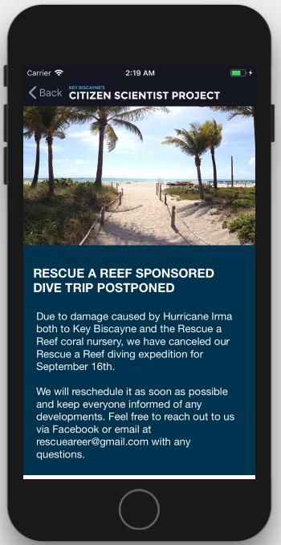
User Story #670 - Create application’s header
Description:
As a user, I want a header that contains the navigation panel button and the application’s logo, so that I can clearly identify the menu and see which application I’m using.
Acceptance Criteria:
Should be permanently fixed on top of the screen, in every page
Logo should be located to the right of the header button
Should have a button to the left of the logo that opens the navigation menu view or that links back to the previous page
Notes:
20 seconds
The tile of user story
Please present and show the complexity of your work, code, algorithms, and technical challenges and technologies you have used. (you could use screenshot if you want. Visual presentations are better than text presentation) - Go into the details of the most important/significant tasks using bullet lists or visual graphs or state chart diagram - Demo using screenshots or GIF (in another separate page if required)
Sequence Diagram for this user story is optional

Slide 13
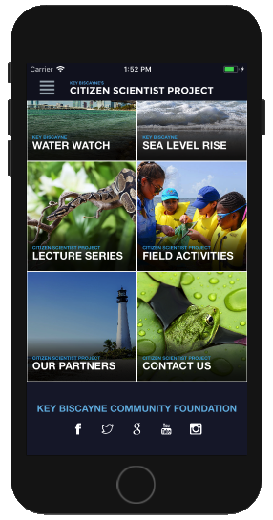
User Story #671 – Social Media Footer
Description:
As a user, I want a footer at the bottom of every page, so that I can recognize the foundation and connect to their social media if I would want to.
Acceptance Criteria:
Should contain all the social media icon links.
Fixed at the bottom of content, not bottom of screen.
Footer label must follow the style guideline provided.
The entire text of the footer label must be visible even on smaller devices.
Notes:
20 seconds
The tile of user story
Please present and show the complexity of your work, code, algorithms, and technical challenges and technologies you have used. (you could use screenshot if you want. Visual presentations are better than text presentation) - Go into the details of the most important/significant tasks using bullet lists or visual graphs or state chart diagram - Demo using screenshots or GIF (in another separate page if required)
Sequence Diagram for this user story is optional

Slide 14
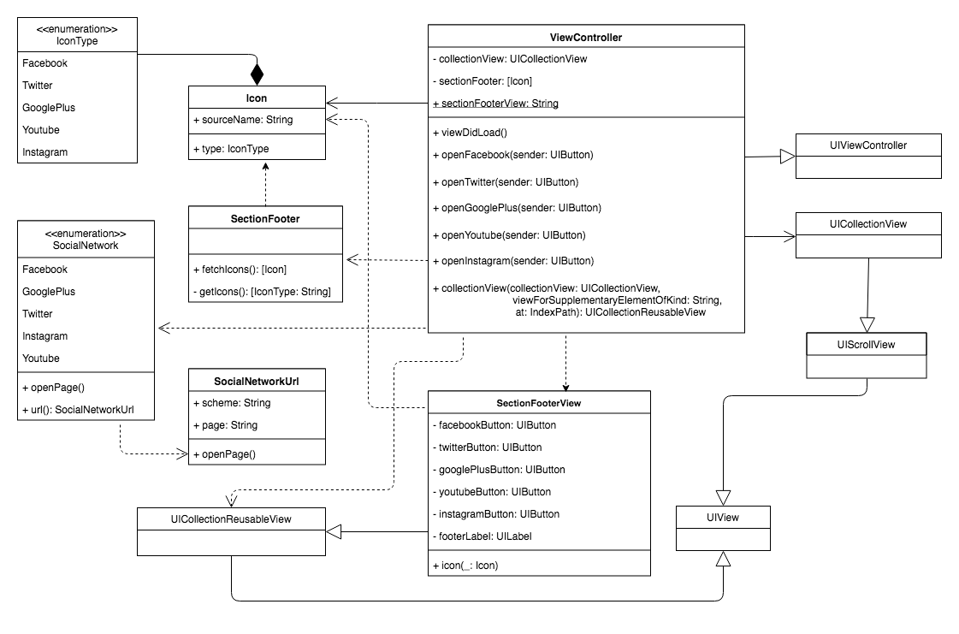
Class Diagram
Notes:
20 seconds
The tile of user story
Please present and show the complexity of your work, code, algorithms, and technical challenges and technologies you have used. (you could use screenshot if you want. Visual presentations are better than text presentation) - Go into the details of the most important/significant tasks using bullet lists or visual graphs or state chart diagram - Demo using screenshots or GIF (in another separate page if required)
Sequence Diagram for this user story is optional

Slide 15
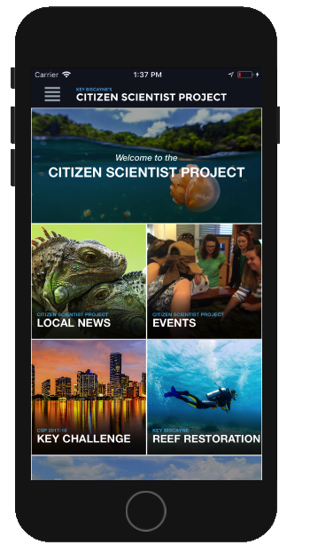
User Story #672 – Create Home page
Description:
As a user, I want a Homepage that showcases certain parts of the application, so that I can have quick & easy access to major areas of the app.
Acceptance Criteria:
Be built in a simple & scalable way.
There should be no broken links in any of the grid items.
When a grid item is clicked it should take you to the page it refers to.
Should be vertically scrollable.
Should be structured as a grid of images & text that link to specific sections of the app.
Labels must follow the style guideline provided.
Notes:
20 seconds
The tile of user story
Please present and show the complexity of your work, code, algorithms, and technical challenges and technologies you have used. (you could use screenshot if you want. Visual presentations are better than text presentation) - Go into the details of the most important/significant tasks using bullet lists or visual graphs or state chart diagram - Demo using screenshots or GIF (in another separate page if required)
Sequence Diagram for this user story is optional

Slide 16
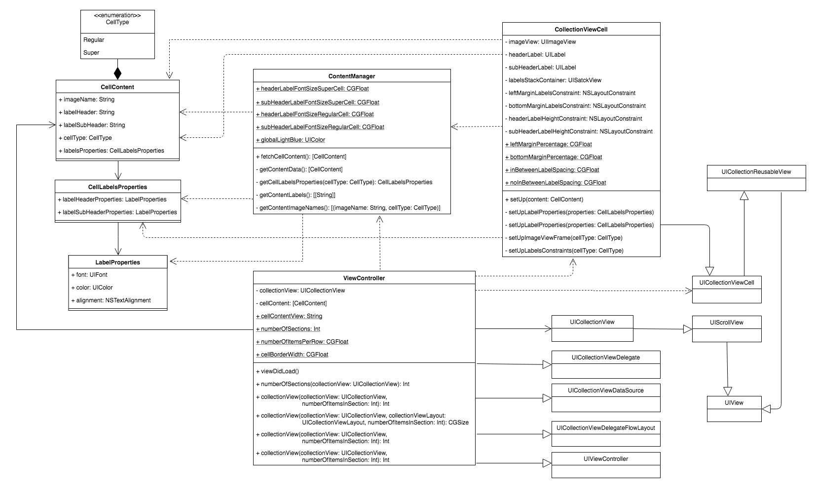
Class Diagram
Notes:
20 seconds
The tile of user story
Please present and show the complexity of your work, code, algorithms, and technical challenges and technologies you have used. (you could use screenshot if you want. Visual presentations are better than text presentation) - Go into the details of the most important/significant tasks using bullet lists or visual graphs or state chart diagram - Demo using screenshots or GIF (in another separate page if required)
Sequence Diagram for this user story is optional

Slide 17
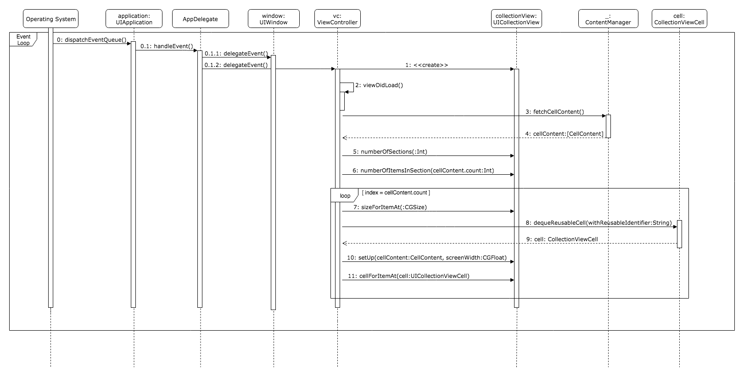
Sequence Diagram
Notes:
20 seconds
The tile of user story
Please present and show the complexity of your work, code, algorithms, and technical challenges and technologies you have used. (you could use screenshot if you want. Visual presentations are better than text presentation) - Go into the details of the most important/significant tasks using bullet lists or visual graphs or state chart diagram - Demo using screenshots or GIF (in another separate page if required)
Sequence Diagram for this user story is optional

Slide 18
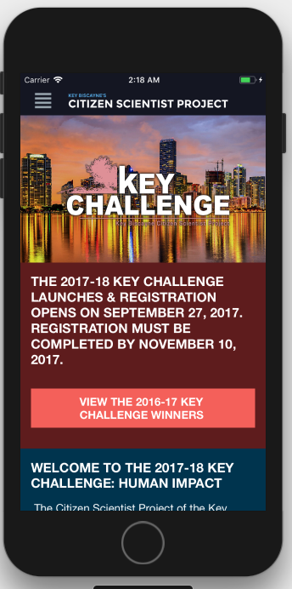
User Story #673 - Create Key Challenge page
Description:
As a user, I want a Key Challenge page that is populated with the content currently found on the website, so that this content can help guide me on which challenges I can join.
Acceptance Criteria:
Be based on (http://www.keyscience.org/projects/key-challenge/)
The CSP, KBCF, and Fairchild logos should be displayed at the bottom of every Key Challenge page, similar to the website since this is a legal matter for the Foundation.
The content should be presented in a single column layout with full width banner imagery while adding other imagery (max-width: 100%;) within large bodies of written content to be aligned above or under it..
Should be a static page
Do NOT have the three registration buttons(send user to browser)
Have the Key Challenge Program PDF
Notes:
20 seconds
The tile of user story
Please present and show the complexity of your work, code, algorithms, and technical challenges and technologies you have used. (you could use screenshot if you want. Visual presentations are better than text presentation) - Go into the details of the most important/significant tasks using bullet lists or visual graphs or state chart diagram - Demo using screenshots or GIF (in another separate page if required)
Sequence Diagram for this user story is optional

Slide 19
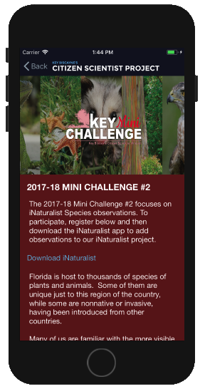
User Story #674 – Create Mini Challenge page
Description:
As a user, I want a Mini Challenge page with all the written content and imagery from the mini challenge website page, so that I can decide if I want to join a mini challenge.
Acceptance Criteria:
Be based on: (http://www.keyscience.org/projects/key-challenge/mini/)
The CSP, KBCF, and Fairchild logos should be displayed at the bottom of the page, like the website since this is a legal matter for the Foundation.
Should be a static page.
Notes:
20 seconds
The tile of user story
Please present and show the complexity of your work, code, algorithms, and technical challenges and technologies you have used. (you could use screenshot if you want. Visual presentations are better than text presentation) - Go into the details of the most important/significant tasks using bullet lists or visual graphs or state chart diagram - Demo using screenshots or GIF (in another separate page if required)
Sequence Diagram for this user story is optional

Slide 20
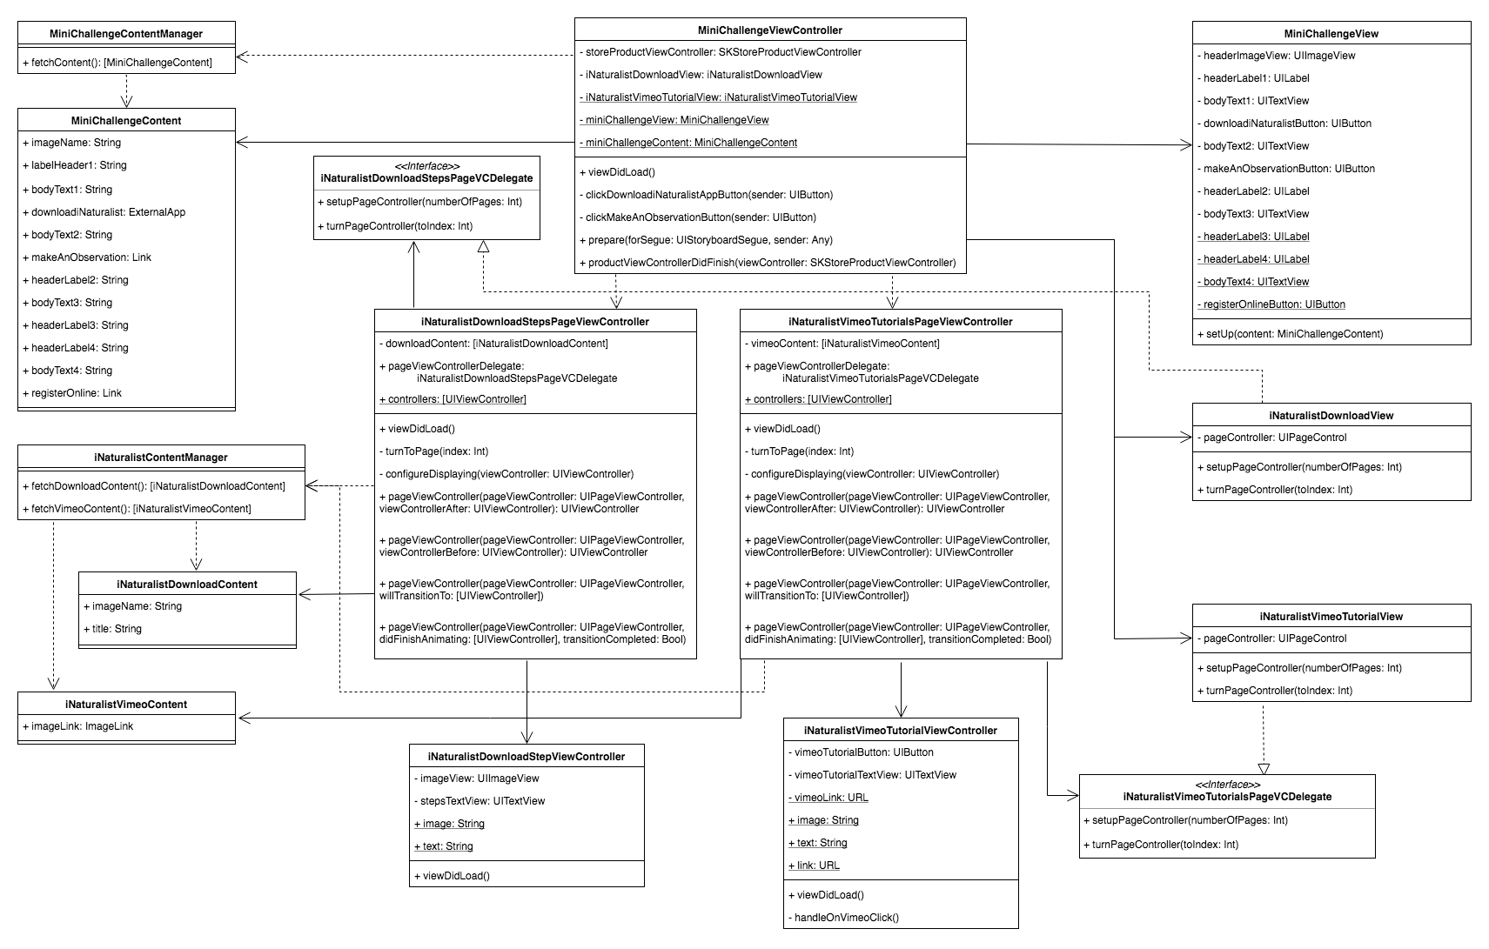
Class Diagram
Notes:
20 seconds
The tile of user story
Please present and show the complexity of your work, code, algorithms, and technical challenges and technologies you have used. (you could use screenshot if you want. Visual presentations are better than text presentation) - Go into the details of the most important/significant tasks using bullet lists or visual graphs or state chart diagram - Demo using screenshots or GIF (in another separate page if required)
Sequence Diagram for this user story is optional

Slide 21
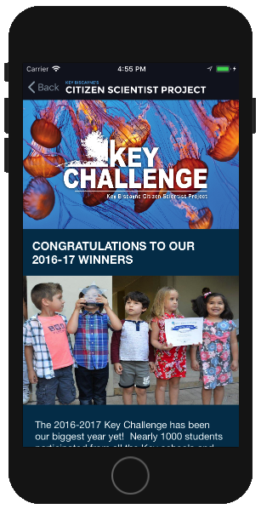
User Story #675 – Create Previous Winners page
Description:
As a user, I want a Previous Winners page that reflects all the content in the website, so that I can use this information as motivation to join a Key Challenge.
Acceptance Criteria:
http://www.keyscience.org/projects/key-challenge/2015-2016-key-challenge-winners/
The CSP, KBCF, and Fairchild logos should be displayed at the bottom of the page, like the website since this is a legal matter for the Foundation.
Content should be shown stacked vertically with expand/hide toggle button to the left of the name because horizontally tabbed content does not translate well to mobile devices.
Notes:
20 seconds
The tile of user story
Please present and show the complexity of your work, code, algorithms, and technical challenges and technologies you have used. (you could use screenshot if you want. Visual presentations are better than text presentation) - Go into the details of the most important/significant tasks using bullet lists or visual graphs or state chart diagram - Demo using screenshots or GIF (in another separate page if required)
Sequence Diagram for this user story is optional

Slide 22
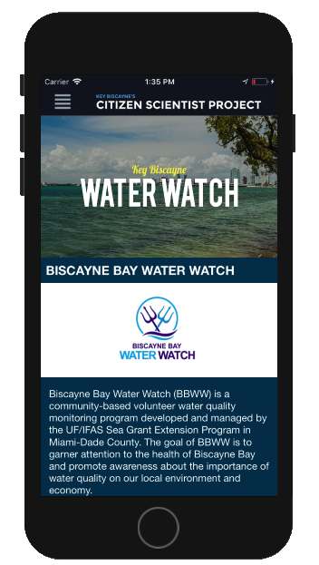
User Story #676 – Create Water Watch page
Description:
As a user, I want a Water Watch page that is populated with the content currently found on the website, so that I can have a way to track the information provided by the Water Watch program through the application.
Acceptance Criteria:
http://www.keyscience.org/projects/key-biscayne-water-watch/
Include the Biscayne Bay Water Watch logo Should be able to view the various graphs and charts as legible, static images.
Page should give access to access all the documents shown in the Water Watch website page, including various PDFs
Notes:
20 seconds
The tile of user story
Please present and show the complexity of your work, code, algorithms, and technical challenges and technologies you have used. (you could use screenshot if you want. Visual presentations are better than text presentation) - Go into the details of the most important/significant tasks using bullet lists or visual graphs or state chart diagram - Demo using screenshots or GIF (in another separate page if required)
Sequence Diagram for this user story is optional

Slide 23
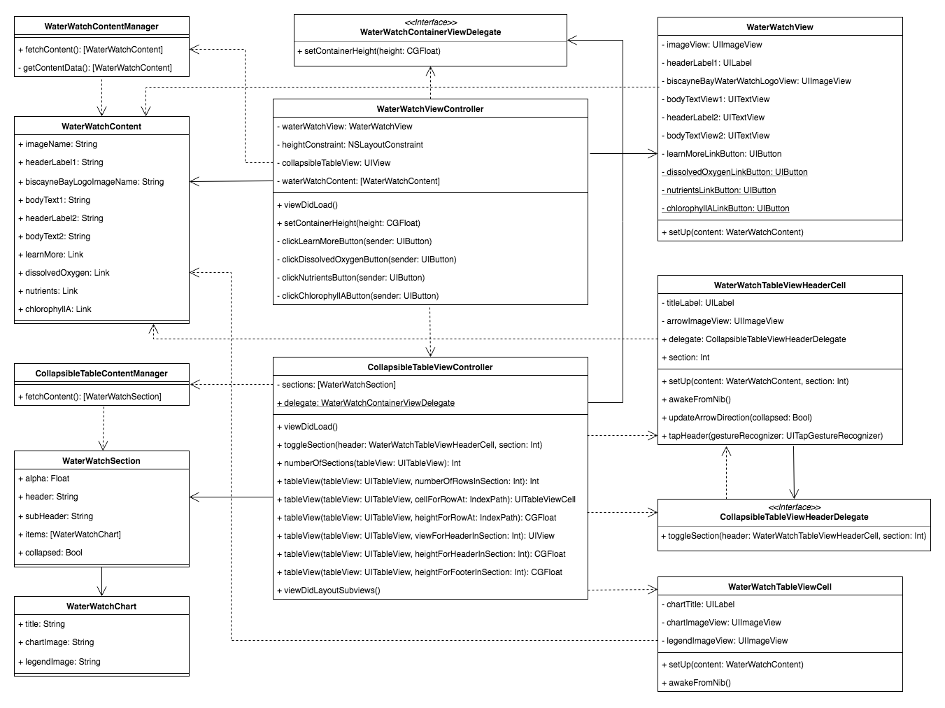
Class Diagram
Notes:
20 seconds
The tile of user story
Please present and show the complexity of your work, code, algorithms, and technical challenges and technologies you have used. (you could use screenshot if you want. Visual presentations are better than text presentation) - Go into the details of the most important/significant tasks using bullet lists or visual graphs or state chart diagram - Demo using screenshots or GIF (in another separate page if required)
Sequence Diagram for this user story is optional

Slide 24
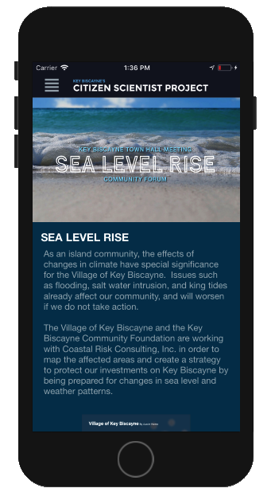
User Story #677 – Create Sea Level Rise page
Description:
As a user, I want a Sea Level Rise page that is populated with the content currently found on the website, so that I can have a way to track how sea level rise is affecting my community through the application.
Acceptance Criteria:
http://www.keyscience.org/projects/sea-level-rise/
The content should be presented in a single column layout with full width banner imagery while adding imagery within large bodies of written content aligned above or under it.
Should give access to all the documents linked to on the Sea Level Rise website page including various PDFs, YouTube videos, Prezi presentation, etc.
Notes:
20 seconds
The tile of user story
Please present and show the complexity of your work, code, algorithms, and technical challenges and technologies you have used. (you could use screenshot if you want. Visual presentations are better than text presentation) - Go into the details of the most important/significant tasks using bullet lists or visual graphs or state chart diagram - Demo using screenshots or GIF (in another separate page if required)
Sequence Diagram for this user story is optional

Slide 25
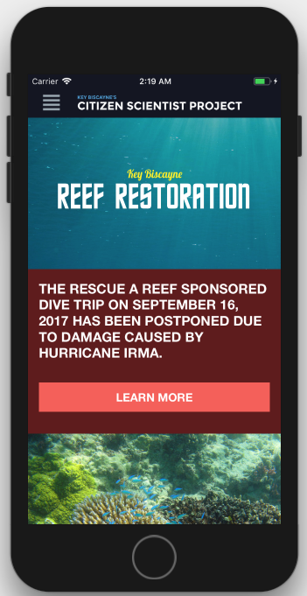
User Story #678 - Create Reef Restoration page
Description:
As a user, I want a Reef Restoration page that is populated with the content currently found on the website, so that I can get informed on how the reef restoration status in Key Biscayne is going.
Acceptance Criteria:
Based on (http://www.keyscience.org/projects/key-biscayne-reef-restoration/)
Content should be presented in a single column layout with a header image and content written under it.
The Rescue a Reef, CSP, and RSMAS logos have to be presented on the bottom of the page just above the footer since this is a legal matter for the Foundation
This page should have a child page that discusses The Foundation’s Dive Trips.
Should be a static page.
Notes:
20 seconds
The tile of user story
Please present and show the complexity of your work, code, algorithms, and technical challenges and technologies you have used. (you could use screenshot if you want. Visual presentations are better than text presentation) - Go into the details of the most important/significant tasks using bullet lists or visual graphs or state chart diagram - Demo using screenshots or GIF (in another separate page if required)
Sequence Diagram for this user story is optional

Slide 26
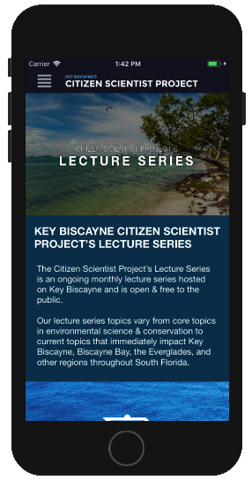
User Story #679 – Create Lecture Series page
Description:
As a user , I want a Lecture Series page that is populated with the content currently found on the website, so that I can have a way to see the lecture series through the application.
Acceptance Criteria:
http://www.keyscience.org/projects/key-biscayne-reef-restoration/
Don't have any of the links back to the Learn section included in the lecture item description.
Should be able to see the Lecture Series page presented in a single column layout
Should not have the Lecture Series Events feed on the Lecture Series page
Notes:
20 seconds
The tile of user story
Please present and show the complexity of your work, code, algorithms, and technical challenges and technologies you have used. (you could use screenshot if you want. Visual presentations are better than text presentation) - Go into the details of the most important/significant tasks using bullet lists or visual graphs or state chart diagram - Demo using screenshots or GIF (in another separate page if required)
Sequence Diagram for this user story is optional

Slide 27
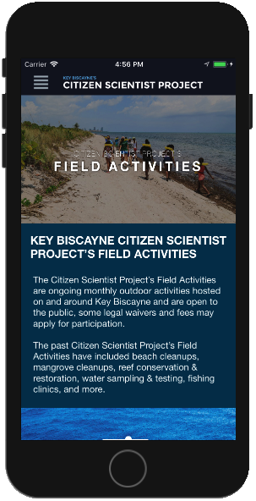
User Story #680 – Create Field Activities page
Description:
As a user, I want a Field Activities page that is populated with the content currently found on the website, so that I can find out about field activities hosted by The Foundation.
Acceptance Criteria:
http://www.keyscience.org/projects/csp-field-activities/
Should not have any of the links back to the Learn section included in the activity item description
Should not show the Field Activity Events feed on the Field Activities page
Should be able to see the Field Activities page presented in a single column layout.
Notes:
20 seconds
The tile of user story
Please present and show the complexity of your work, code, algorithms, and technical challenges and technologies you have used. (you could use screenshot if you want. Visual presentations are better than text presentation) - Go into the details of the most important/significant tasks using bullet lists or visual graphs or state chart diagram - Demo using screenshots or GIF (in another separate page if required)
Sequence Diagram for this user story is optional

Slide 28
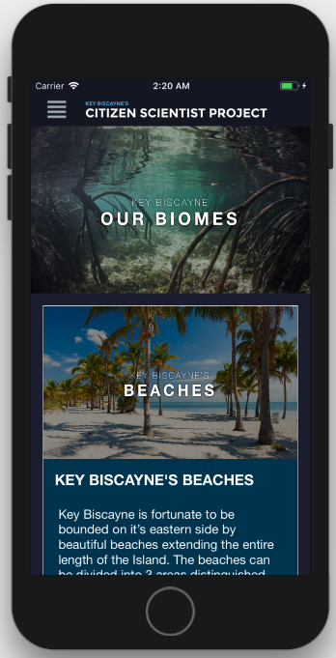
User Story #681 Create Our Biomes page
Description:
As a user, I want a Biomes page that shows me a list of Biomes I can visit, so that I can aware of some of the natural resources in Key Biscayne or Virginia Key.
Acceptance Criteria:
Be based on (https://www.keyscience.org/resources/biomes/)
Should have child pages for each Biomes
Should have partners logos and social media footer in the bottom of the page
Notes:
20 seconds
The tile of user story
Please present and show the complexity of your work, code, algorithms, and technical challenges and technologies you have used. (you could use screenshot if you want. Visual presentations are better than text presentation) - Go into the details of the most important/significant tasks using bullet lists or visual graphs or state chart diagram - Demo using screenshots or GIF (in another separate page if required)
Sequence Diagram for this user story is optional

Slide 29
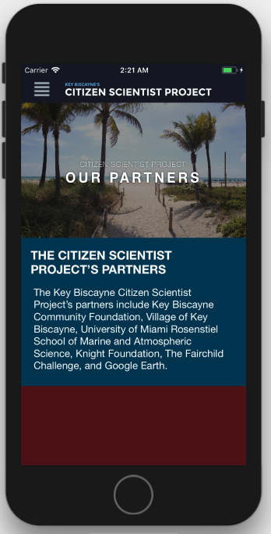
User Story #682 Create Our Partners page
Description:
As a user, I want a Biomes page that shows me a list of Biomes I can visit, so that I can aware of some of the natural resources in Key Biscayne or Virginia Key.
Acceptance Criteria:
Be based on (https://www.keyscience.org/resources/biomes/)
Should have child pages for each Biomes
Should have partners logos and social media footer in the bottom of the page
Notes:
20 seconds
The tile of user story
Please present and show the complexity of your work, code, algorithms, and technical challenges and technologies you have used. (you could use screenshot if you want. Visual presentations are better than text presentation) - Go into the details of the most important/significant tasks using bullet lists or visual graphs or state chart diagram - Demo using screenshots or GIF (in another separate page if required)
Sequence Diagram for this user story is optional

Slide 30
User Story #693 - Create Reef Restoration - Dive Trip page
Description:
As a user, I want to be able to know the status of the Dive Trip that is hosted by the Rescue a Reef program, so that I can stay up to date with it.
Acceptance Criteria:
Based on (http://www.keyscience.org/rescue-a-reef-sponsored-dive-trip-postponed/​)
Content should be presented in a single column layout with a header image and content written under it.
Do not include any sidebar content from the website
This page should have a simple “Back” button that takes the user back to the parent page
The Rescue a Reef, CSP, and RSMAS logos have to be presented on the bottom of the page above the footer since this is a legal matter for the Foundation
This page is a child of Reef Restoration and can only be accessed via Reef Restoration.
Should be a static page.
Notes:
20 seconds
The tile of user story
Please present and show the complexity of your work, code, algorithms, and technical challenges and technologies you have used. (you could use screenshot if you want. Visual presentations are better than text presentation) - Go into the details of the most important/significant tasks using bullet lists or visual graphs or state chart diagram - Demo using screenshots or GIF (in another separate page if required)
Sequence Diagram for this user story is optional

Slide 31
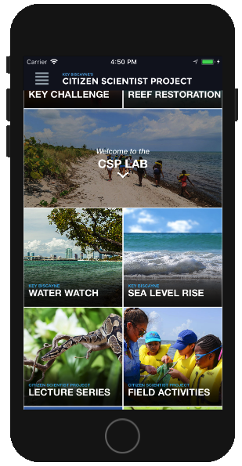
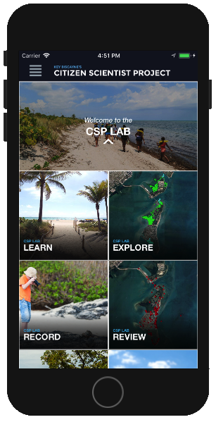
User Story #712 – Expand CSP Lab
Description:
As a user, I would like the CSP Lab cell in the homepage to be expandable so that I can see the child pages.
Acceptance Criteria:
When the CSP Lab cell is expanded the following children elements should show: Learn, Explore, Record and Review.
When the CSP Lab cell is retracted the children elements should not be visible.
Notes:
20 seconds
The tile of user story
Please present and show the complexity of your work, code, algorithms, and technical challenges and technologies you have used. (you could use screenshot if you want. Visual presentations are better than text presentation) - Go into the details of the most important/significant tasks using bullet lists or visual graphs or state chart diagram - Demo using screenshots or GIF (in another separate page if required)
Sequence Diagram for this user story is optional

Slide 32
Test Case Example
Test case ID | Navigation_Unit_Test_04
Purpose | From the Navigation page, the user should be able to press on any table cell that references another page and afterwards get redirected to that page.
Pre-conditions | The user must have a running version of the application in their phone The application must be running and in view The user must be viewing the Navigation page
Expected Results | View changes to referenced page when the table cell is pressed in the Navigation page
Actual Result | After the user presses a table cell their view gets changed to the view referenced in the table cell, this includes the table cells: “Home”, “Profile”, “Geo Hunt”, “Learn”, “Explore”, “Record”, “Review”, “Key Challenge”, “Sea Level Rise”, “Water Watch”, “Reef Restoration”, Lecture Series”, “Field Activities”, “Events”, “News”, “About Us”, “Our Biomes”, “Newsletters”, “Out Partners” and “Contact Us”.
Status | Pass
Notes:
10 seconds
A description of verification process and Test Suites and Test Cases for one of the use cases.

Slide 33






Summary
The Citizen Scientist Project iOS App 1.0 is the first release of an application which aims to expand on The Key Biscayne Citizen Scientist Project’s mission by integrating a new system into their platform which will allow users to be able to monitor, protect and share information on the most critical natural resources of Key Biscayne. In this release, the team focused on the application’s core user interface, architecture and offline-static pages.
Any Questions?
Notes:
10 seconds
Summarize your contribution, mention your effort for Scrum, Mingle, Github, Google Drive Documentation and minutes
Ask if anyone has any questions for you.

Slide 34
Thank You!
Contact Information:
Emmanuel Malave, Application Developer - emala003@fiu.edu
David Gonzalez, Application Developer - dgonz137@fiu.edu
Nathan Moyer, Product Owner - nathanmoyer@lightmadeliquid.com
Notes:
10 seconds
Thank your audience
Include your contact information

